Slide 1



NETWORK 1 SOLUTIONS, LLC
Training - Lift King

Slide 2



“The Mission of Network 1 Solutions is to design products to solve problems that have existed in the collision and mechanical industry for too long.”
Key items and goals we focus on when designing products
Increase Safety
Reduce Human Strain
Improve quality by avoiding the potential for damage
Increase Productivity
Durable rugged design for longevity
Multi-use application
Minimal floor space needed
Built in the U.S.
“DELIVERING OEM-QUALITY PRODUCTS IS JUST THE BEGINNING.”
2

Slide 3


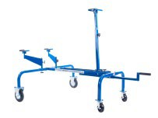
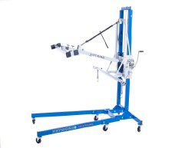
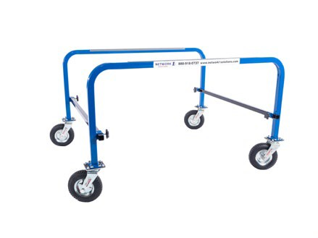
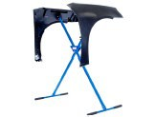
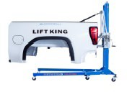
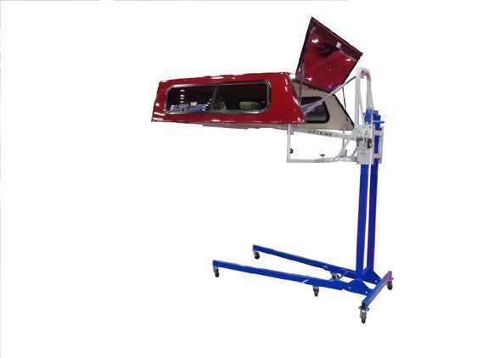
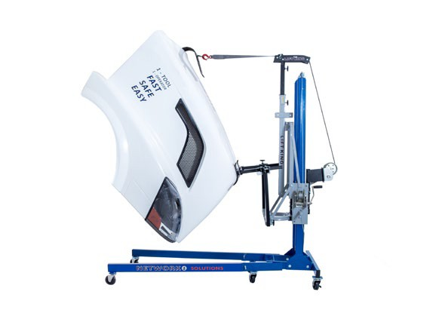
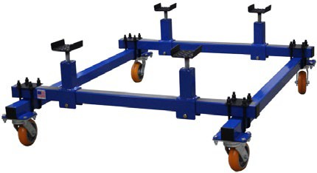
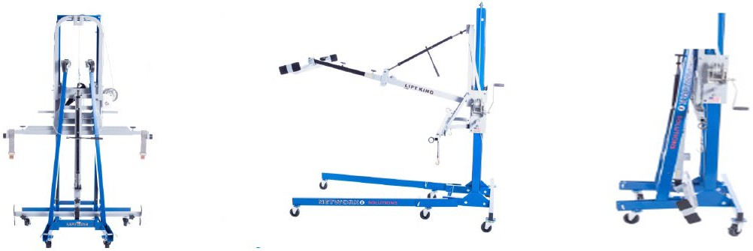
PRODUCT LINE
Lift King - Main Component
Box Attachment
Bushing Kit
Stabilizer Bar
Stabilizer Carriage
Box Dolly
Tilt Boom
Topper Attachment
Fender Paint Stand
Vehicle Dolly
Semi Hood Attachment
Semi Hood Dolly
Fifth Wheel Attachment
Door Attachment (Coming Soon)
3
“We're Your Partner In Profitability.”

Slide 4

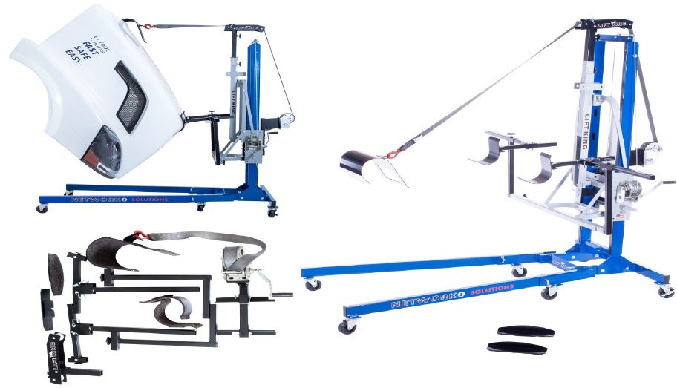
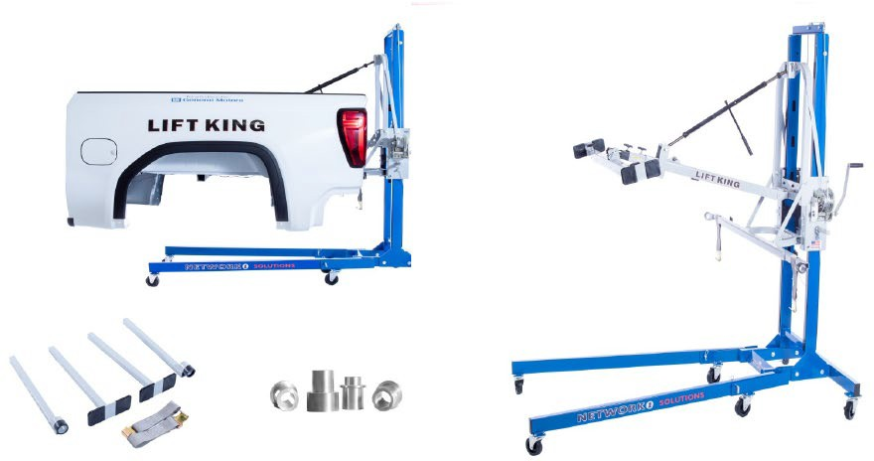
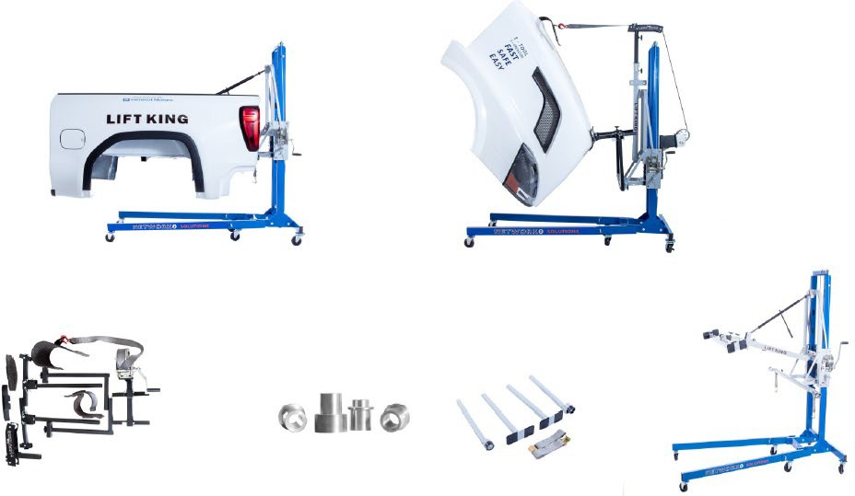

Lift King Heavy Duty
PACKAGES
Lift King Light Duty
Perfect for Heavy Duty Collision Shops, Service
Departments and Restoration Facilities
Lift King Combo
Perfect for Collision Shops, Service
Departments and Restoration Facilities
4

Slide 5

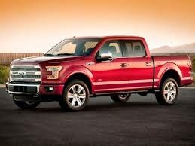
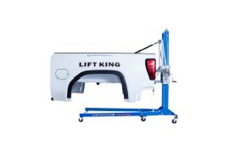
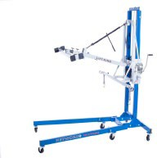
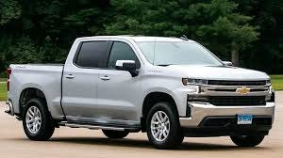



Light Duty Package
What is it? The Lift King Light Duty Package contains everything necessary to remove and install pickup beds with only one operator in a matter of minutes! Our Lift King makes taking any OEM pickup bed off safely and quickly and allows the other technicians to stay focused on their job as no help is needed when using the Lift King. The Light Duty Package includes everything needed to remove and install a pick-up bed of any size including dually beds.
One Tech – One Tool
5

Slide 6

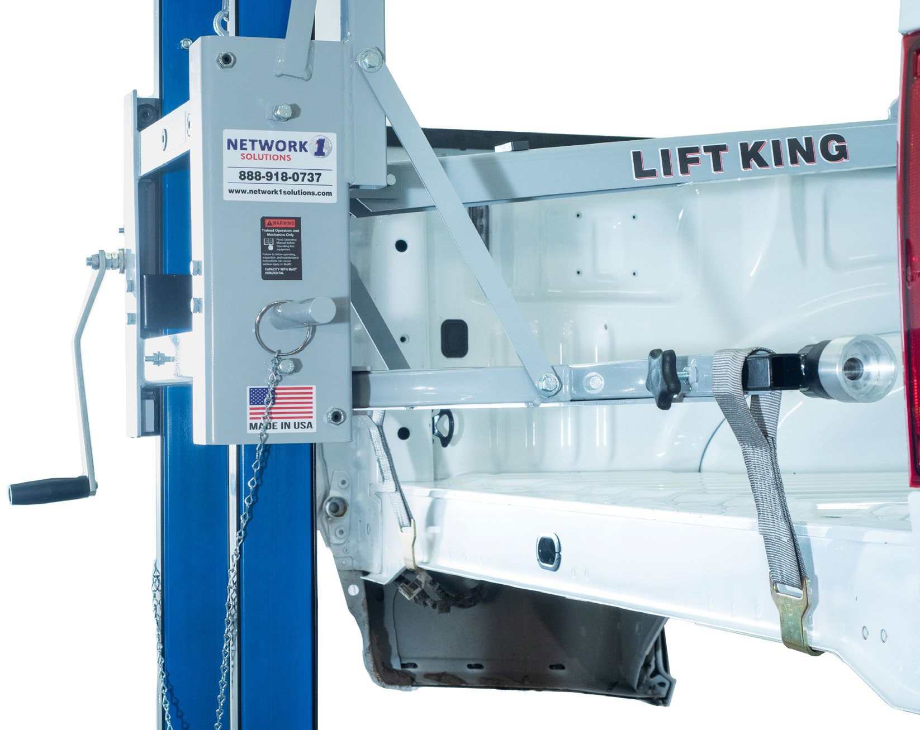
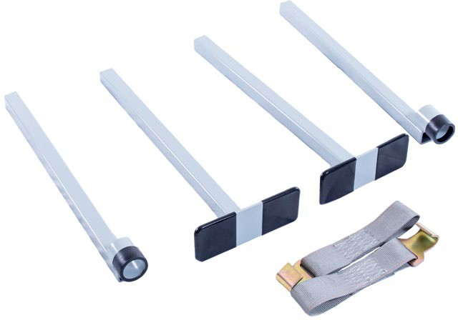

Secondary Rear Mount Feature
6

Slide 7

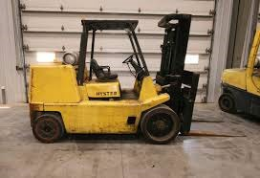
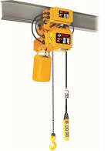
Who is the competition? Forklift, four technicians, overhead chain fall system, an engine hoist with an “H” pattern component.
Why choose the Lift King?
Improves safety by avoiding physical strain
Improves quality by reducing the chance of damage to a customer vehicle
Increase productivity by reducing the need of four technicians to only one
7

Slide 8

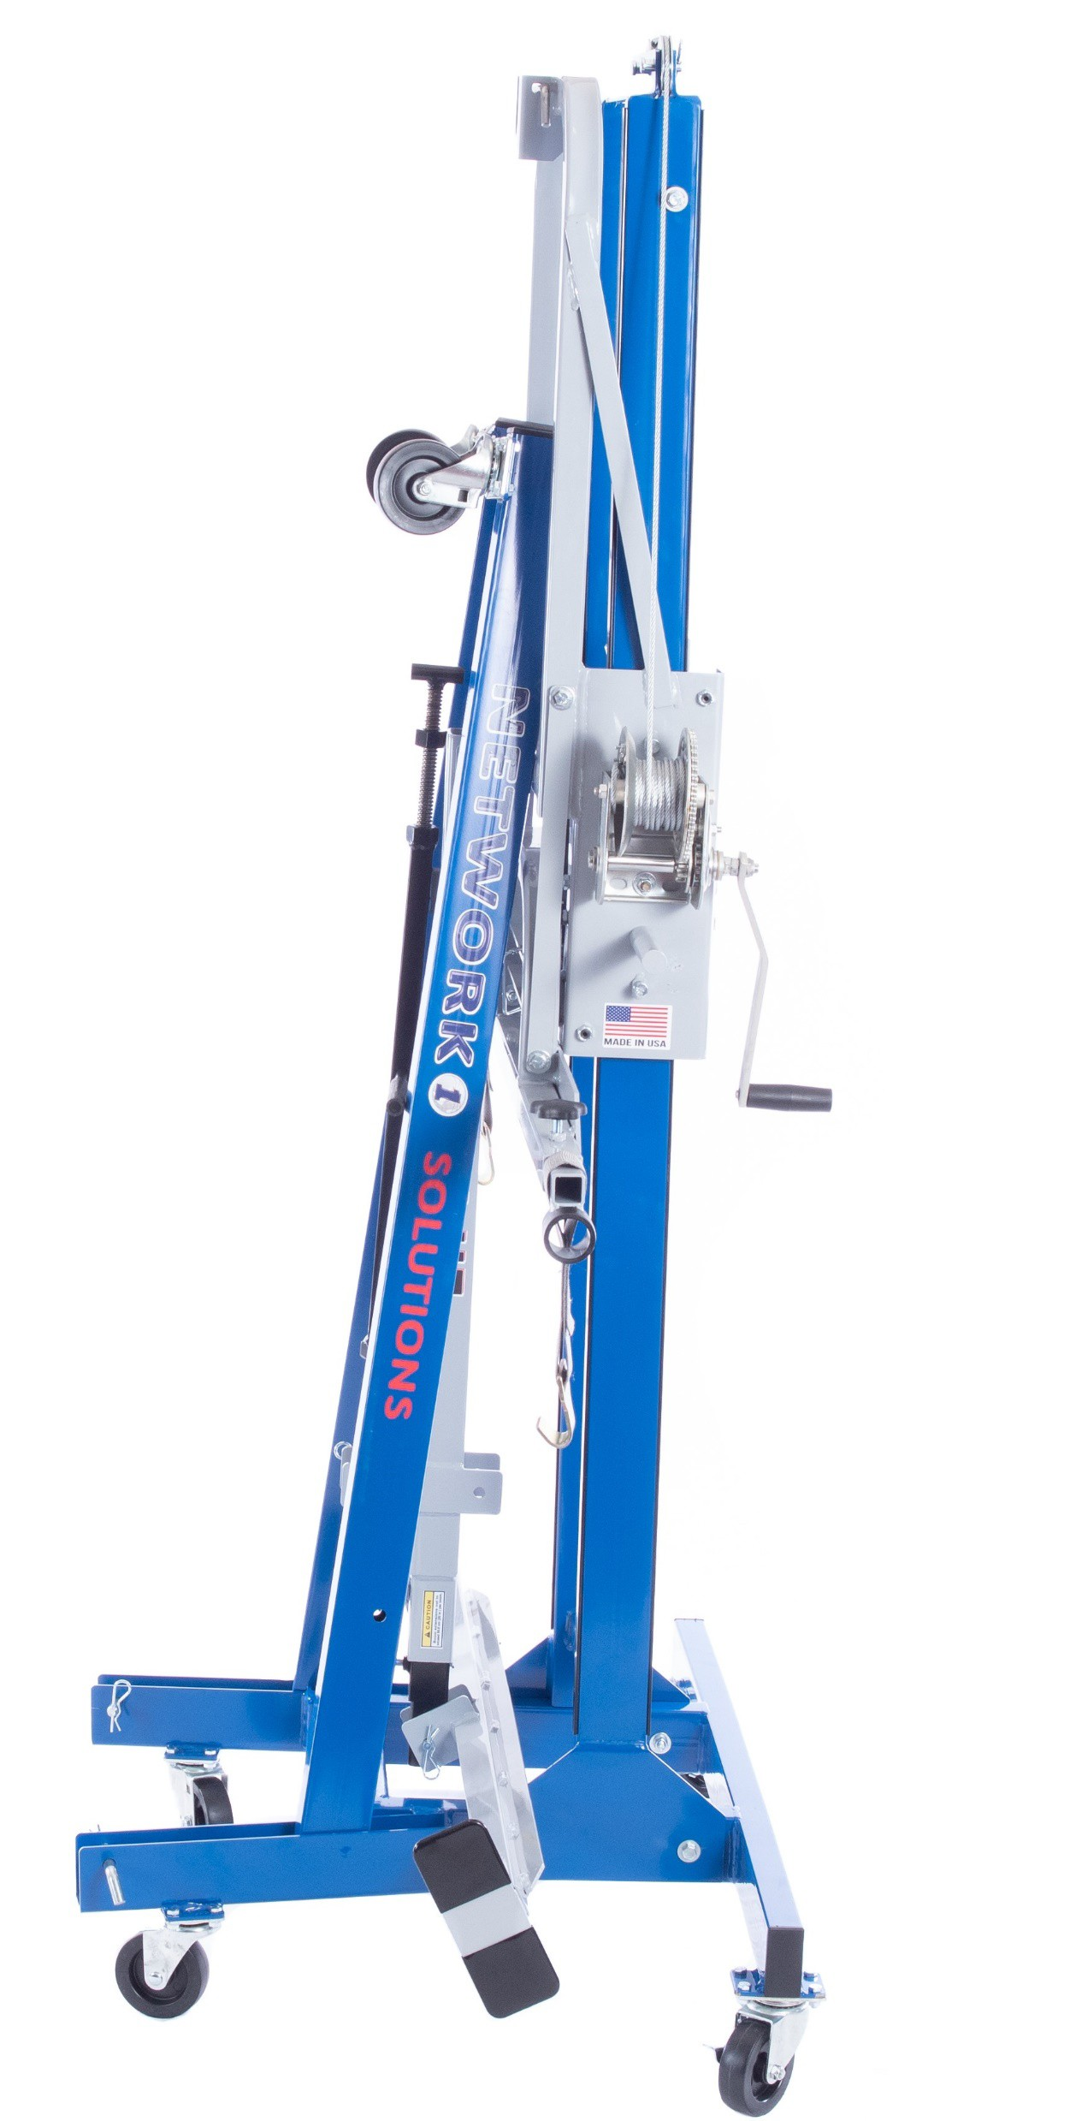
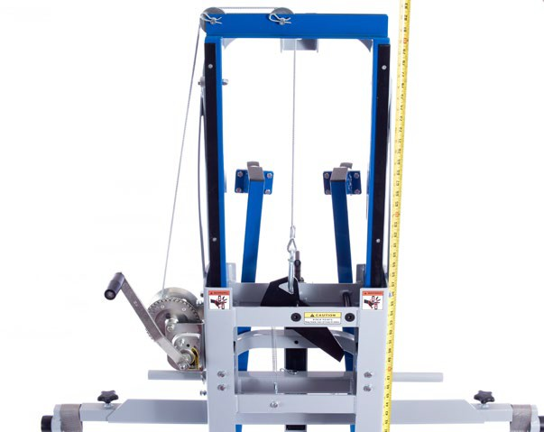
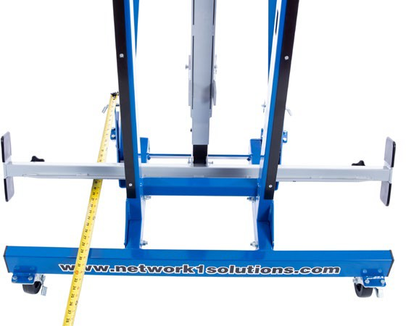
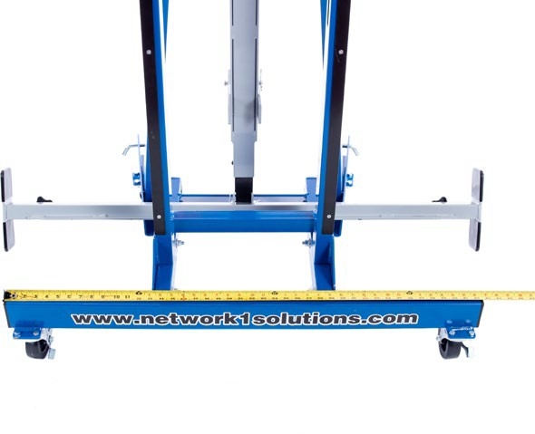
Lift King Dimensions
83 inches
30 inches
42.5 inches
8

Slide 9

Objections
Why would a mechanical shop need a Lift King?
The Lift King will cut labor time in half when installing a fuel pump.
When the Lift King is folded in the stored position, how much time does it require to set-up and what tools are needed?
An average technician working at normal speed can set up the Lift King ready for work in only a couple minutes with NO tools needed.
Will the Lift King lift a dually bed?
The average dually bed weighs 385 lbs, the Lift King is rated for 500 lbs, it has been tested and passed at 1,000 lbs and comes with a 1,600 lbs braking winch. Lifting a dually bed is an easy process with the Lift King.
How will I lift a new bed that does not have any hardware on it?
There is a secondary rear mount feature (seat belt strap style with hook). This is used for beds without tailgate hinge pins or if the truck was in a bad rear collision and the bed damage has the bed out of square.
How long before the Lift King pays for itself?
The second you buy the Lift King you reduce the chance of a worker liability claim and immediately improve productivity.
9

Slide 10

The most common way shops currently remove or install pickup beds are with four technicians. The actual technician performing the repair spends an average of fifteen minutes recruiting three or four helpers, five minutes removing or installing the bed and an additional ten minutes before all technicians are back to work. This adds up to thirty minutes multiplied by four technicians. The same process repeats itself when the pickup bed is re-installed.
The average repair facility loses four billable hours removing and installing a pickup bed and is exposed to liability potentials and possible quality issues. When using the Lift King the average amount of time spent reduces from four hours to less than one hour and eliminates human strain and possible injury also saving time and money.
https://youtu.be/pKm1qsNQzxE
10

Slide 11
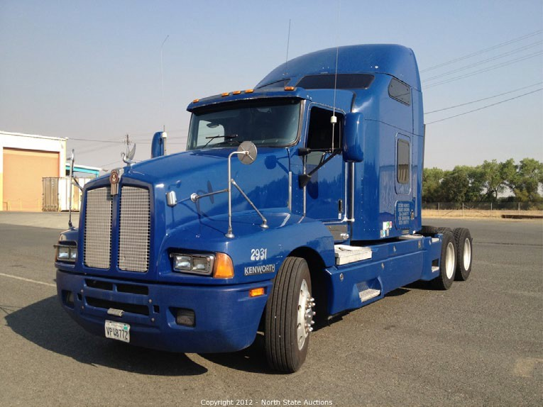
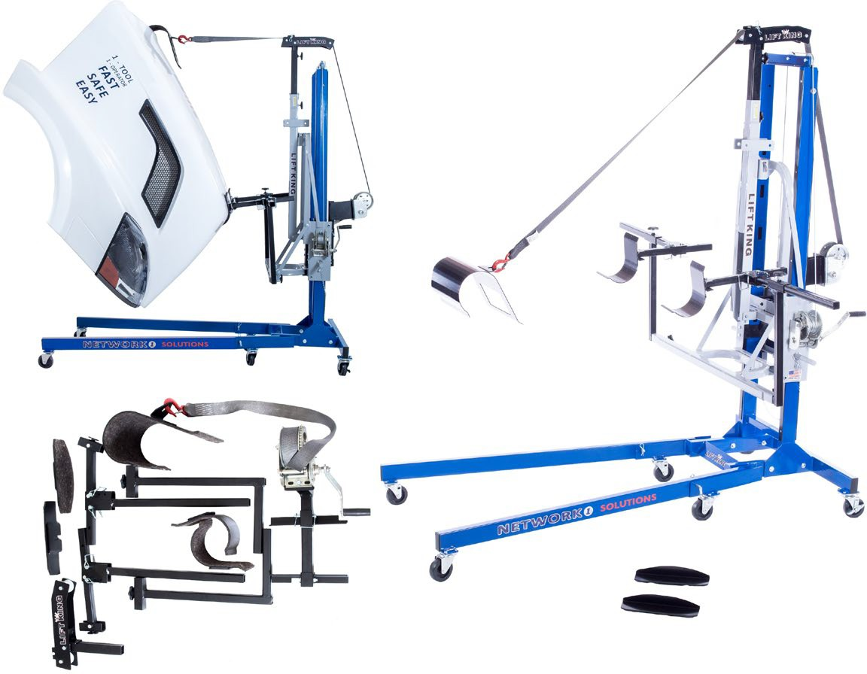
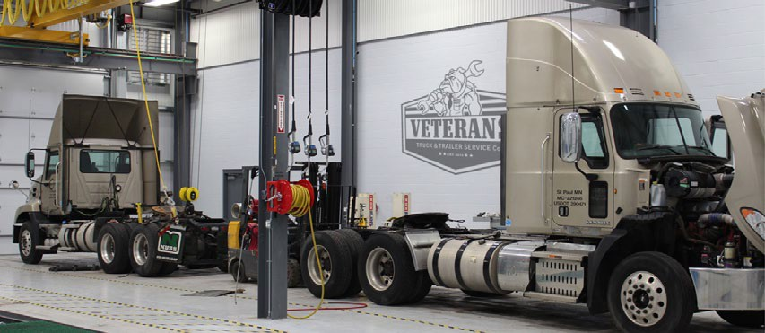
Heavy Duty Package
What is it? The Lift King Heavy Duty Package contains everything necessary to remove and install semi hoods with only one operator in a matter of minutes! Our Lift King makes taking any semi hood off safely and quickly and allows the other technicians to stay focused on their job as no help is needed when using the Lift King. The Heavy Duty Package includes everything needed to remove and install a semi hood of any size including straight trucks, dump trucks and buses. The Semi Hood Attachment also works with the new Ford F-650 and F-750 trucks.
One Tech – One Tool
11

Slide 12
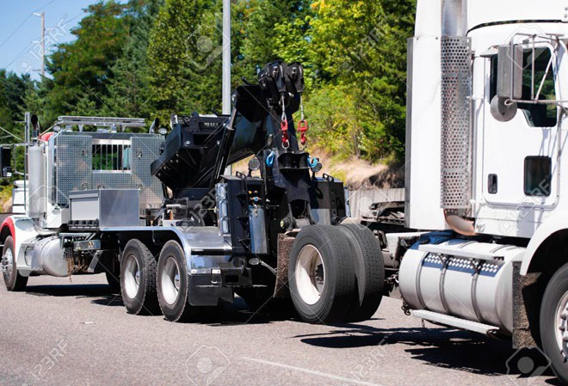


Why the Lift King is preferred?
Who is the competition? Forklift, four technicians, overhead chain fall system or other unsafe practices.
Improves safety by avoiding physical strain
Increase productivity by reducing the need of four technicians to only one
Improves quality by reducing the chance of damage to a customer’s vehicle
12

Slide 13

Objections
Why would a mechanical shop need a Lift King?
The Lift King will cut labor time for repairs. Most repairs require the hood to be removed.
When the Lift King is folded in the stored position, how much time does it require to set-up and what tools are needed?
An average technician working at normal speed can set up the Lift King ready for work in only a couple minutes with NO tools needed.
It will take too much floor space.
When folded in the stored position, the Lift King needs only 3 square feet of floor space.
Do I have to remove the grill?
Only if you want to rotate the hood into the open or closed position while performing repairs to it. The secondary mount allows the hood to be lifted in an upward or lowered position (same as 4 technicians) without the grill removed.
Can I push the hood around the shop while on the Lift King?
YES, it is a very easy process.
13

Slide 14
The most common way shops currently remove or install semi hoods are with four technicians. The actual technician performing the repair spends an average of fifteen minutes recruiting three or four helpers, five minutes removing or installing the hood and an additional ten minutes before all technicians are back to work. This adds up to thirty minutes multiplied by four technicians. The same process repeats itself when the semi hood is re-installed.
The average repair facility losses four billable hours removing and installing a semi hood and is exposed to liability potentials and possible quality issues. When using the Lift King the average amount of time spent reduces from four hours to less than one hour and eliminates human strain and possible injury. This saves MONEY and TIME.
https://youtu.be/PS8z1P36ZbM
14

Slide 15

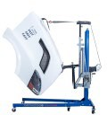
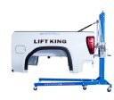



Combo Package
One Tech – One Tool
What is it? The Lift King Combo Package contains everything necessary to remove and install pickup beds and semi hoods with only one operator in a matter of minutes! Our Lift King makes taking any pickup bed and semi hood off safely and quickly and allows the other technicians to stay focused on their job as no help is needed when using the Lift King. Switching from one attachment to the other can be done within minutes and NO tools needed.
15

Slide 16

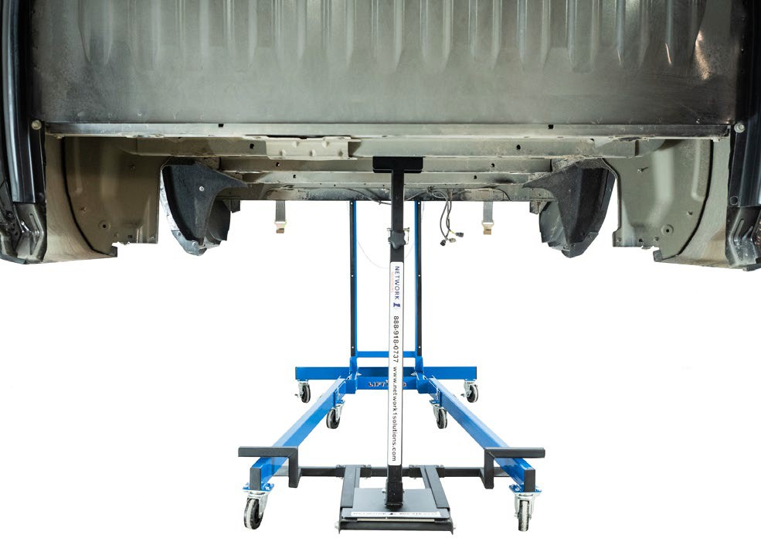
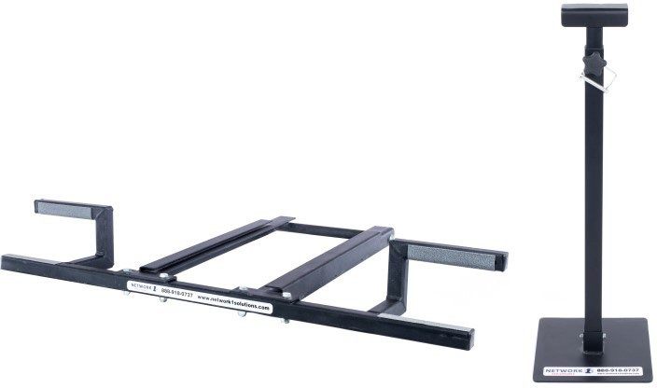

Stabilizer Kit
The Stabilizer Kit contains everything necessary to reduce front end bounce of a pickup bed while it remains on the Lift King, while collision repairs are being performed. The Stabilizer Kit can be installed on the Lift King within seconds. The Stabilizer Carriage straddles the legs of the Lift King and the Stabilizer Bar slides into the Carriage for fast set up. The Stabilizer Bar is telescopic so the technician can adjust it into position. This will eliminate the bounce.
https://youtu.be/9XNnS17Sg3E
16

Slide 17

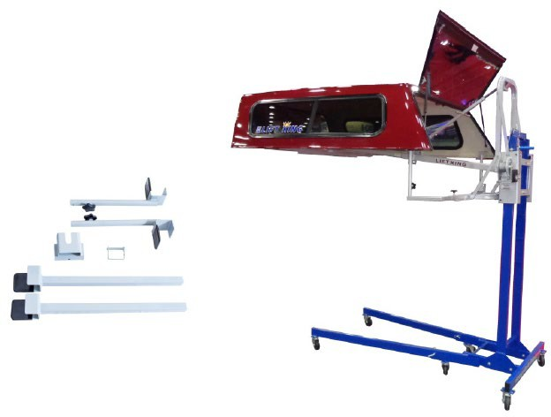
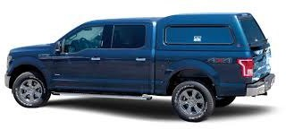
Topper Attachment
The Topper Attachment includes everything needed for the Lift King to remove and install toppers.
One person can remove or install a topper quickly
Great option when repairing or painting toppers
The Topper Attachment connects to the Lift King in seconds
Move the topper around the shop with one person at ease.
17

Slide 18


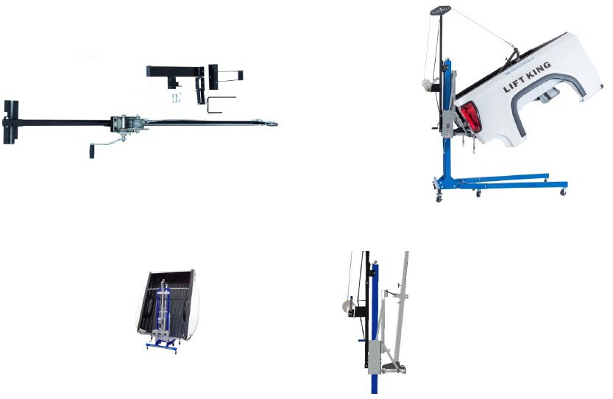
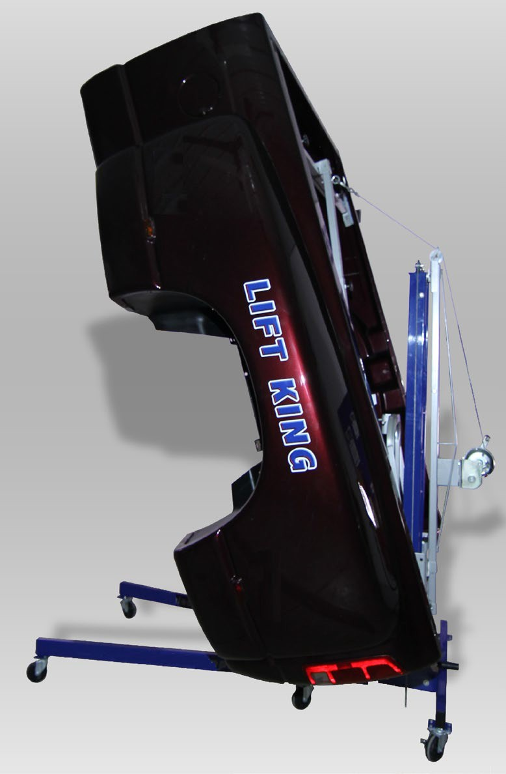
Tilt Boom Attachment
The Tilt Boom Attachment is a great addition to the Lift King for custom shops, restoration shops, and collision shops that have the need to tilt a pickup box in an upward vertical position.
One person can remove or install a topper quickly
Great option when repairing or painting toppers
The Topper Attachment connects to the Lift King in seconds
Move the topper around the shop with one person at ease.
18

Slide 19

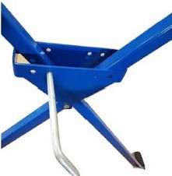
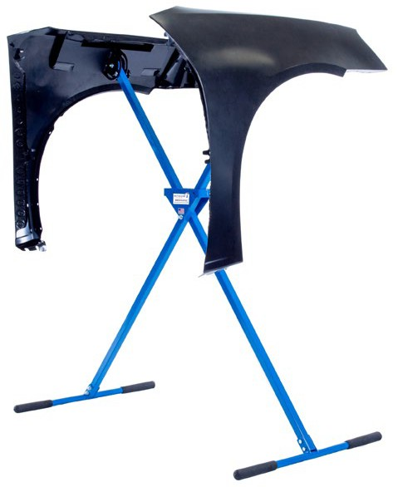
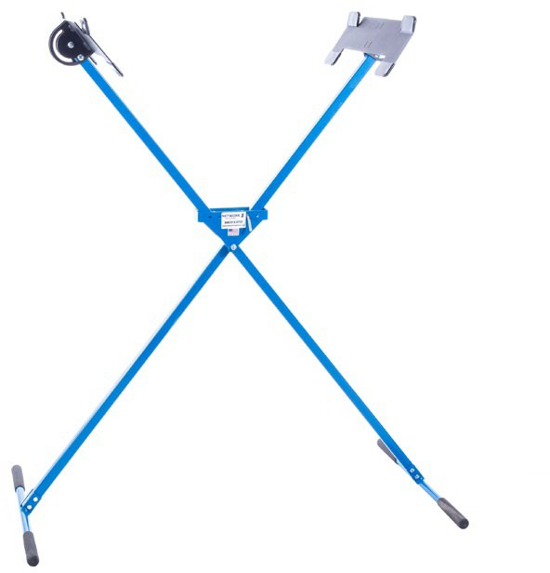
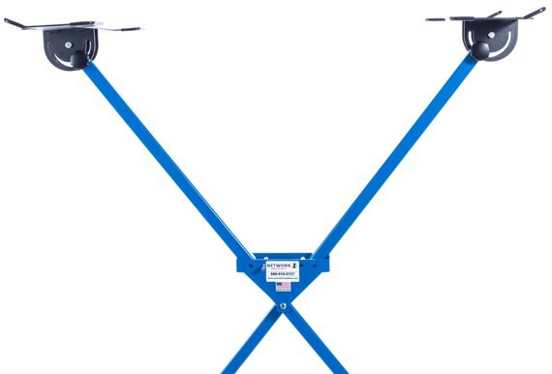
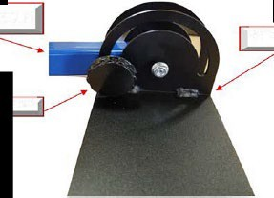
Fender Paint Stand
The fender stand is a great inexpensive, sturdy and well-designed stand for painting fenders.
19

Slide 20
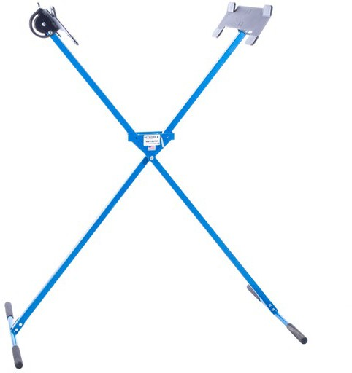

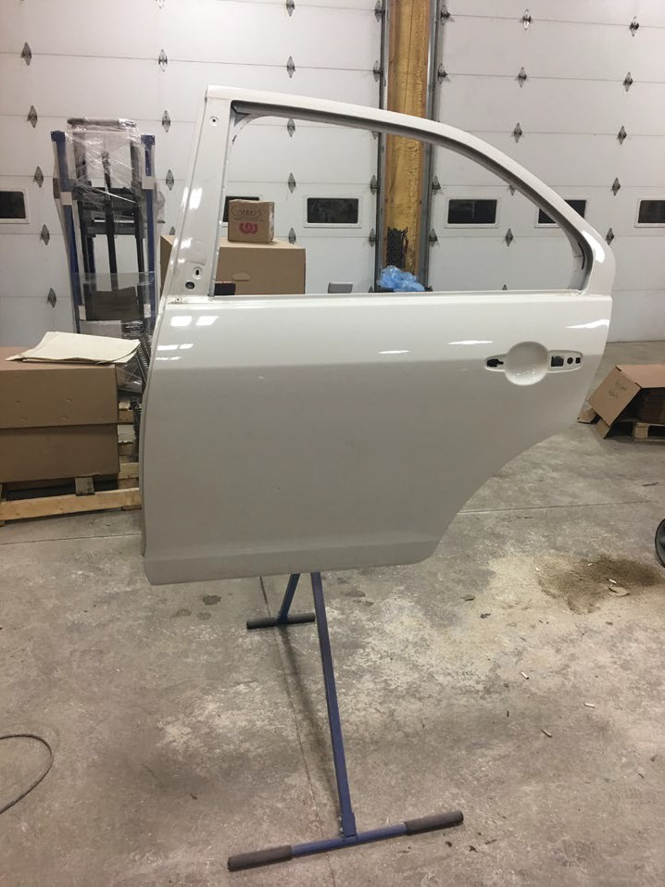
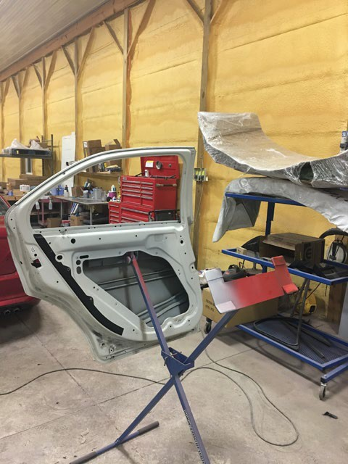

Key Benefits
Folds up for easy storage
Unfolds and ready to use in seconds
Completely adjustable for several different fender designs
No pins or clamps required (most competitors have pins and clamps) this allows the painter to spray the fender and jam with no shadowing.
This will also improve quality because the paint and clearcoat thickness is the same (no shadowing due to no pins or clamps) so no flaking or chipping in the future.
Very sturdy with one or two fenders
Several shops use it as a paint stand for many other items such as mirrors, trim parts, bumpers and even doors.
https://youtu.be/IXnMSOFgzuA
20

Slide 21

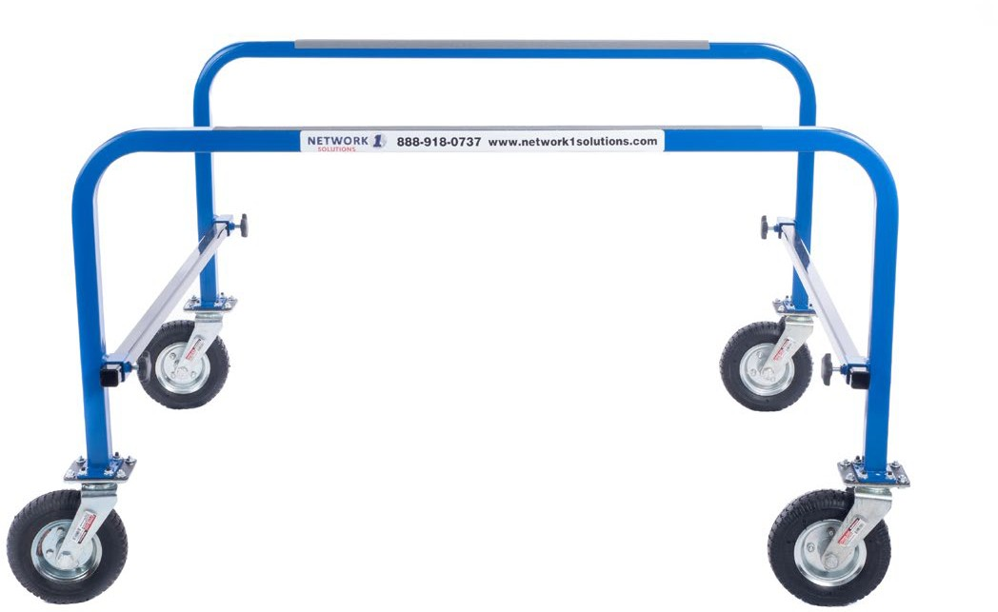
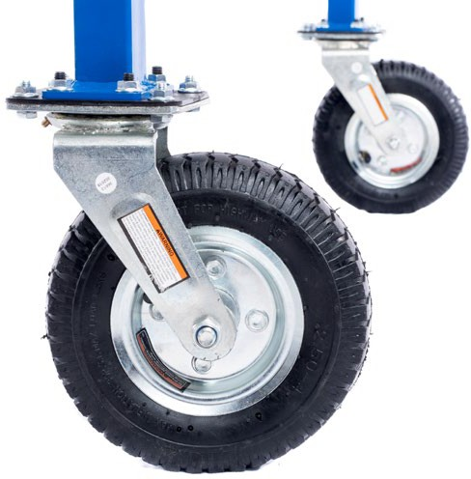
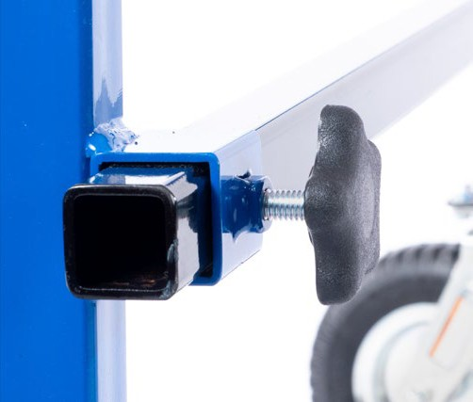
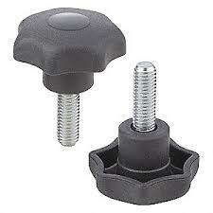

Box Dolly
The box dolly is built out of steel construction, has a powder coat finish, and is very durable. The 8“ swivel casters makes pushing a pickup bed in or out of a paint booth or around the shop an easy task.
The 8” casters allows it to roll easy with any size pickup bed
The rugged design allows it to be overloaded without stress cracks or weld breaks
Adjustable with the four star knobs
It breaks down in seconds with no tools needed and can be hung on a wall mount to store without the need of floor space.
https://youtu.be/hZ1_DGz0VPU
21

Slide 22
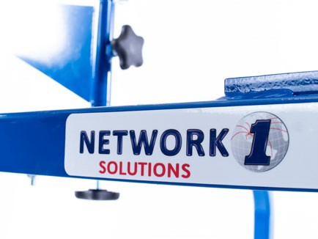

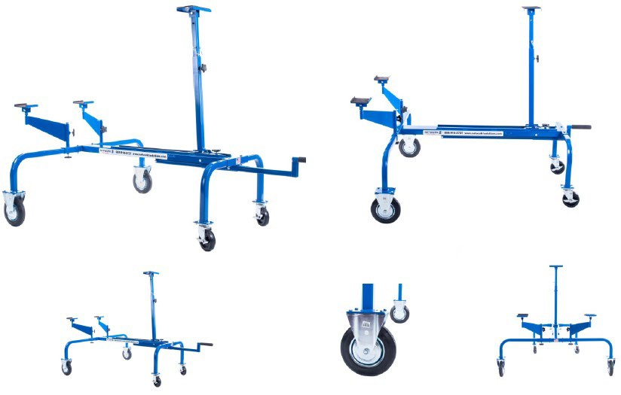

Semi Hood Dolly
The Semi Hood Dolly is a great dolly to place semi hoods on while repairs are being performed to the truck or the hood. Most shops place the semi hood on the shop floor when removed from the truck and are at risk of scratching or scraping the hood. When the hood is stored on the floor, it is typically in the way of other technicians while performing their repairs. In most situations it is required to be moved with the labor of three or four technicians lifting and physically handling it.
22

Slide 23



Key Benefits
Place the hood on the dolly when off the truck and avoid the potential for scratches or scrapes
If the hood needs to be relocated, extend the extension handle and move the hood around the shop at ease with one technician
Perform collision repairs to the hood while on the dolly
Move the hood in or out of the paint booth easily
The Semi Hood Dolly is a great way for a busy shop to keep their Lift King free to remove or install other hoods.
Will it work with most hood designs? Yes! The swivel arms are designed to move from side to side and tilt. This allows the technician to adjust the swivel arms to fit with all hood designs. The vertical slide bar is telescopic and will adjust for different designs.
This will take too much floor space: No! Push the extension handle in, lower the vertical slide bar, and stand the dolly upward with the front down against the wall or in a corner.
23

Slide 24



5th Wheel Attachment
What is it? An attachment for the Lift King to remove or install 5th wheel plates.
What are the applications? The Lift King with the 5th Wheel Attachment is designed for one technician to remove and install 5th wheel plates with no human lifting or physical strain. This application works well on pickups, semi’s, and any other type of trucks with a 5th wheel plate.
Who uses it? Collision shops, service departments, and repair facilities for both light duty and heavy-duty trucks.

Slide 25



Why choose the Lift King with the 5th Wheel Attachment?
Improves safety by avoiding physical strain and human injury
Increase productivity by reducing the need of two technicians or more to only one and cut the labor time by more than 50%
Attaches to the Lift King in a few seconds with no tools needed
Completely adjustable to accommodate any truck with a 5th Wheel Plate including light duty and heavy duty
Fast, simple, and safe process that saves the shop time and money

Slide 26
Objections
I have a forklift, why would I need this? When using a forklift three technicians are typically required. one technician to drive the forklift and two technicians to lift the fifth wheel plate so the forklift driver can get the forks under the 5th wheel. The forklift driver may be able to perform this without the other two technicians as long as scratches and potential damage is acceptable.
How much work is it to set up the Lift King and attach the 5th Wheel Attachment? A technician can set up the Lift King and the 5th Wheel Attachment in a couple of seconds. Much quicker than getting the forklift.
Can the 5th wheel plate be lowered to the floor or does it have to sit on a pallet? The Lift King will allow the 5th wheel plate to be lowered to the floor and can be raised as high as needed to remove it from a freight truck.
Can the Lift King put the 5th wheel plate in the exact position required to secure it to the truck frame or will I need a second technician at that point? The Lift King is a ONE TECH, ONE TOOL operation for every attachment. The winch and the turn buckle will allow for a precise adjustment to position it exactly as needed.
Light Duty
https://youtu.be/hXt3vKmL2Y8
Heavy Duty
https://youtu.be/1wGtP5r0VjE

